Slide 1
CSIT988/CSIT488 Security, Ethics and Professionalism Week 10: Risk management: controlling risk
Subject Coordinator: Guangyou Zhou
Central China Normal University
Spring 2024

Slide 2
Introduction
To keep up with the competition, organizations must design and create a safe environment in which business processes and procedures can function
This environment must maintain confidentiality and privacy and assure the integrity and availability of organizational data
These objectives are met via the application of the principles of risk management

Slide 3
Risk Control Strategies
After creating the ranked vulnerability worksheet, an organization must choose one of four basic strategies to control risks
Avoidance
Applying safeguards that eliminate or reduce the remaining uncontrolled risks for the vulnerability
Transference
Shifting the risk to other areas or to outside entities
Mitigation
Reducing the impact if the vulnerability is exploited
Acceptance
Understanding the consequences and accepting the risk without control or mitigation

Slide 4
Avoidance
The risk control strategy that attempts to prevent the exploitation of the vulnerability
Preferred approach since it seeks to avoid risk rather than deal with it after it has been realized.
Avoidance is accomplished through:
Application of policy
Application of training and education
Countering threats
Implementation of technical security controls and safeguards

Slide 5
Transference
The control approach that attempts to shift the risk to other assets, other processes, or other organizations
May be accomplished by rethinking how services are offered
Revising deployment models
Outsourcing to other organizations
Purchasing insurance
Implementing service contracts with providers

Slide 6
Mitigation
The control approach that attempts to reduce the damage caused by the exploitation of vulnerability
Using planning and preparation
Depends upon the ability to detect and respond to an attack as quickly as possible
Types of mitigation plans
Disaster recovery plan (DRP)
Incident response plan (IRP)
Business continuity plan (BCP)

Slide 7
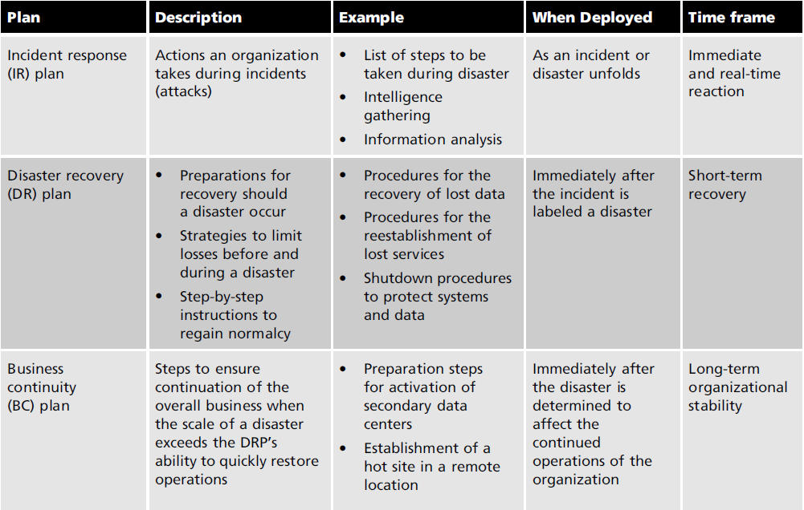
Mitigation (cont’d.)

Slide 8
Acceptance
The choice to do nothing to protect an information asset
To accept the loss when it occurs
This control, or lack of control, assumes that it may be a prudent business decision to examine the alternatives and conclude that the cost of protecting an asset does not justify the security expenditure

Slide 9
Acceptance
Before using the acceptance strategy, the organization must:
Determine the level of risk to the information asset
Assess the probability of attack and the likelihood of a successful exploitation of a vulnerability
Approximate the annual rate of occurrence of the exploit
Estimate the potential loss from attacks
Perform a thorough cost benefit analysis
Evaluate controls using each appropriate type of feasibility
Decide that the particular asset did not justify the cost of protection

Slide 10
Managing Risk
Risk appetite (also known as risk tolerance)
The quantity and nature of risk that organizations are willing to accept
As they evaluate the trade-offs between perfect security and unlimited accessibility
The reasoned approach to risk is one that balances the expense (in terms of finance and the usability of information assets) against the possible losses if exploited

Slide 11
Managing Risk (cont’d.)
Residual risk
When vulnerabilities have been controlled as much as possible, there is often remaining risk that has not been completely removed, shifted, or planned for
Residual Risk is a combined function of:
Threats, vulnerabilities and assets, less the effects of the safeguards in place

Slide 12
Managing Risk (cont’d.)
The goal of information security is not to bring residual risk to zero
Bring it in line with an organization’s risk appetite
If decision makers have been informed of uncontrolled risks and the proper authority groups within the communities of interest decide to leave residual risk in place, then the information security program has accomplished its primary goal

Slide 13
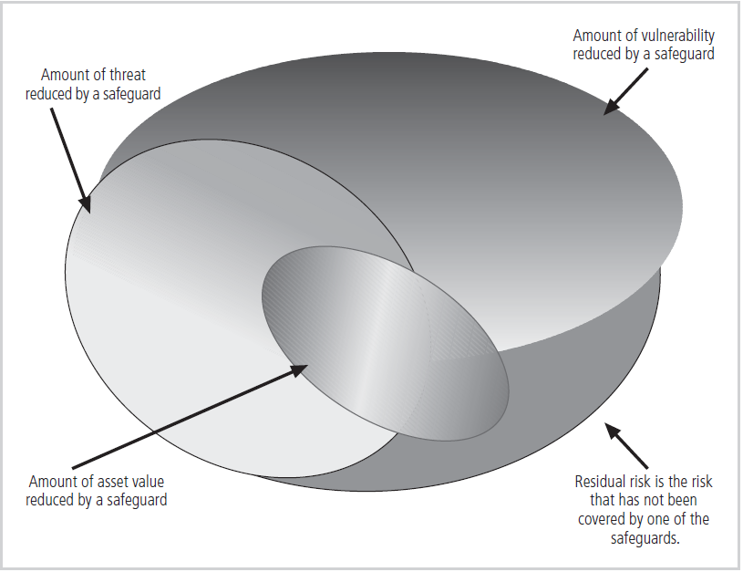
Managing Risk (cont’d.)

Slide 14
Managing Risk (cont’d.)
Once a control strategy has been selected and implemented:
The effectiveness of controls should be monitored and measured on an ongoing basis
To determine its effectiveness and the accuracy of the estimate of the residual risk

Slide 15
Managing Risk (cont’d.)
Risk control involves selecting one of the four risk control strategies
For the vulnerabilities present
If the loss is within the range of losses the organization can absorb, or if the attacker’s gain is less than expected costs of the attack, the organization may choose to accept the risk
Otherwise, one of the other control strategies will have to be selected

Slide 16
Managing Risk (cont’d.)
Guidelines for risk control strategy selection
When a vulnerability exists
Implement security controls to reduce the likelihood of a vulnerability being exercised
When a vulnerability can be exploited
Apply layered controls to minimize the risk or prevent occurrence
When the attacker’s potential gain is greater than the costs of attack
Apply technical or managerial controls to increase the attacker’s cost, or reduce his gain
When potential loss is substantial
Apply design controls to limit the extent of the attack, thereby reducing the potential for loss

Slide 17
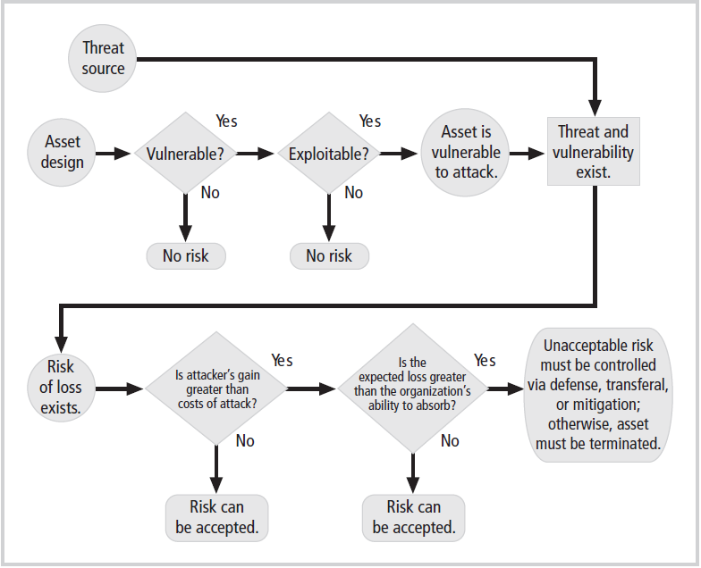
Managing Risk (cont’d.)

Slide 18
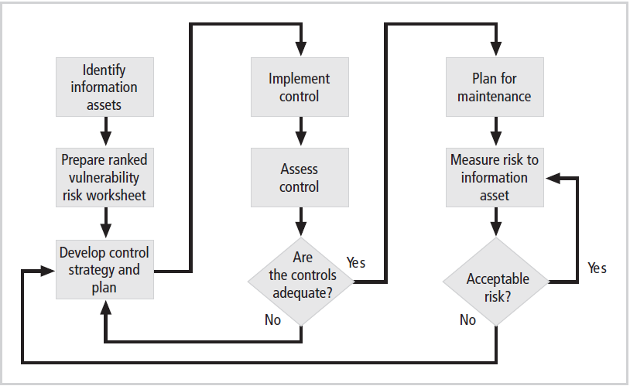
Managing Risk (cont’d.)
Figure 9-3 Risk control cycle

Slide 19
Feasibility and Cost-Benefit Analysis
Before deciding on the strategy for a specific vulnerability
All readily accessible information about the consequences of the vulnerability must be explored
Ask “what are the advantages of implementing a control as opposed to the disadvantages of implementing the control?”
There are a number of ways to determine the advantage or disadvantage of a specific control
The primary means are based on the value of the information assets that it is designed to protect

Slide 20
Cost-Benefit Analysis (CBA)
Economic feasibility
The criterion most commonly used when evaluating a project that implements information security controls and safeguards
Begin a cost-benefit analysis by:
Evaluating the worth of the information assets to be protected and the loss in value if those information assets are compromised
This decision-making process is called
Cost-benefit analysis or economic feasibility study

Slide 21
Cost-Benefit Analysis (cont’d.)
It is difficult to determine the value of information
It is also difficult to determine the cost of safeguarding it
Factors that affect the cost of a safeguard
Cost of development or acquisition of hardware, software, and services
Training fees
Cost of implementation
Service and maintenance costs

Slide 22
Cost-Benefit Analysis (cont’d.)
Benefit
The value to the organization of using controls to prevent losses associated with a specific vulnerability
Usually determined by valuing the information assets exposed by the vulnerability and then determining how much of that value is at risk and how much risk there is for the asset
This is expressed as the annualized loss expectancy (ALE)

Slide 23
Cost-Benefit Analysis (cont’d.)
Asset valuation
The process of assigning financial value or worth to each information asset
The value of information differs within and between organizations
Based on the characteristics of information and the perceived value of that information
Involves estimation of real and perceived costs associated with the design, development, installation, maintenance, protection, recovery, and defense against loss and litigation

Slide 24
Cost-Benefit Analysis (cont’d.)
Asset valuation components
Value retained from the cost of creating the information asset
Value retained from past maintenance of the information asset
Value implied by the cost of replacing the information
Value from providing the information
Value acquired from the cost of protecting the information

Slide 25
Cost-Benefit Analysis (cont’d.)
Asset valuation components (cont’d.)
Value to owners
Value of intellectual property
Value to adversaries
Loss of productivity while the information assets are unavailable
Loss of revenue while information assets are unavailable

Slide 26
Cost-Benefit Analysis (cont’d.)
An organization must be able to place a dollar value on each information asset it owns, based on:
How much did it cost to create or acquire?
How much would it cost to recreate or recover?
How much does it cost to maintain?
How much is it worth to the organization?
How much is it worth to the competition?

Slide 27
Cost-Benefit Analysis (cont’d.)
Potential loss is that which could occur from the exploitation of vulnerability or a threat occurrence
Ask these questions:
What loss could occur, and what financial impact would it have?
What would it costs to recover from the attack, in addition to the financial impact of damage?
What is the single loss expectancy for each risk?

Slide 28
Cost-Benefit Analysis (cont’d.)
A single loss expectancy (SLE)
The calculation of the value associated with the most likely loss from an attack
SLE is based on the value of the asset and the expected percentage of loss that would occur from a particular attack
SLE = asset value (AV) x exposure factor (EF)
Where EF is the percentage loss that would occur from a given vulnerability being exploited
This information is usually estimated

Slide 29
Cost-Benefit Analysis (cont’d.)
In most cases, the probability of a threat occurring is the probability of loss from an attack within a given time frame
This value is commonly referred to as the annualized rate of occurrence (ARO)
ALE = SLE * ARO

Slide 30
Cost-Benefit Analysis (cont’d.)
CBA determines whether or not a control alternative is worth its associated cost
CBAs may be calculated before a control or safeguard is implemented
To determine if the control is worth implementing
Or calculated after controls have been implemented and have been functioning for a time

Slide 31
Cost-Benefit Analysis (cont’d.)
Cost-benefit analysis formula
CBA = ALE(prior) – ALE(post) – ACS
ALE (prior to control) is the annualized loss expectancy of the risk before the implementation of the control
ALE (post-control) is the ALE examined after the control has been in place for a period of time
ACS is the annual cost of the safeguard

Slide 32
Calculate SLE, ARO, and ALE for each threat category
XYZ Software Company, major threat categories for new applications development (Asset value: $1,200,000 in projected revenues)
 | Cost per incident | Frequency of occurrence
Programmer mistakes | $5,000 | 1 per month
Loss of intellectual property | $75,000 | 1 per 2 years
Theft of information | $2,500 | 1 per quarter
Web defacement | $500 | 1 per month
Theft of equipment | $5,000 | 1 per 2 years
Virus | $1,500 | 1 per week
Fire | $500,000 | 1 per 10 years

Slide 33
Other Methods of Establishing Feasibility
Organizational feasibility analysis
Examines how well the proposed information security alternatives will contribute to the operation of an organization
Operational feasibility
Addresses user and management acceptance and support
Addresses the overall requirements of the organization’s stakeholders

Slide 34
Other Methods of Establishing Feasibility (cont’d.)
Technical feasibility
Examines whether or not the organization has or can acquire the technology to implement and support the alternatives
Political feasibility
Defines what can and cannot occur based on the consensus and relationships between the communities of interest

Slide 35
Alternatives to Feasibility Analysis
Benchmarking
Due care and due diligence
Best business practices
Gold standard
Government recommendations
Baseline

